Slide 1

CAFÉ CHATBOT

Slide 2
Instructor: Md Al-Imran
Department of CSE
East West University
Group Members: Mahmud Jamil(2017-2-60-147)
Farhat Jebin (2017-2-60-059)
Md. Fahimul Islam(2017-1-62-022)
Dipayan Gosh()
Al Mashror Partho()
CSE 365
ARTIFICIAL INTELLIGENCE

Slide 3
Project Description
We live in a modern technological world. Now a days specialy in a business purpose it is very important to response the all customer enquire in random timimg .But It is very difficult to responses all the customers during whole day and night. It is one kind of impossible task for a human .So We try to develop a system to reduce this problem . Our project aims to solve the problem and responsed the customer in all 24 hours .
We developed a system that is a chatbot and focuses on its implementation with in the business. A chatbot platform used with the intention of obtaining leads seems to be an in fact the main focus of this work is that including this method can be one of the main axes of obtaining information about consumers with their asking enquire and get immediate response. This system should save our time and cost as well .

Slide 4
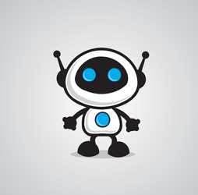
OVERVIEW IN OUR PROJECT
✔️ CHATBOT
✔️ DEVELOPMENT
✔️ CHALLENGES
✔️ INTEGRATIONS
✔️ ADVANTAGE & DISADVANTAGE
✔️ LIMITATIONS
✔️ FUTURE WORKS

Slide 5
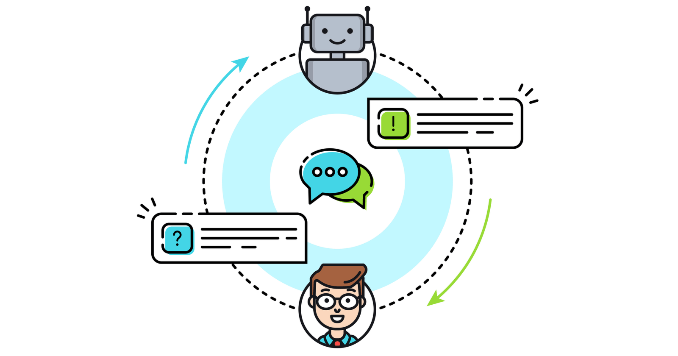
What is a chatbot?
A chatbot can be defined as an AI based computer program that simulates human conversations. They are also known as digital assistants that understand human capabilities. Bots interpret the user intent, process their requests, and give prompt relevant answers.
Bots can communicate through voice as well as text and can be deployed across websites, applications, and messaging channels such as Facebook Messenger, Twitter, or Whatsapp.

Slide 6
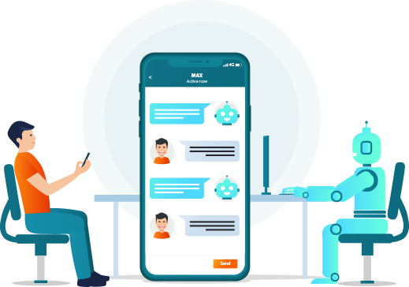
CAFÉ CHATBOT
OUR AGENT
: CAFÉ CHATBOT

Slide 7
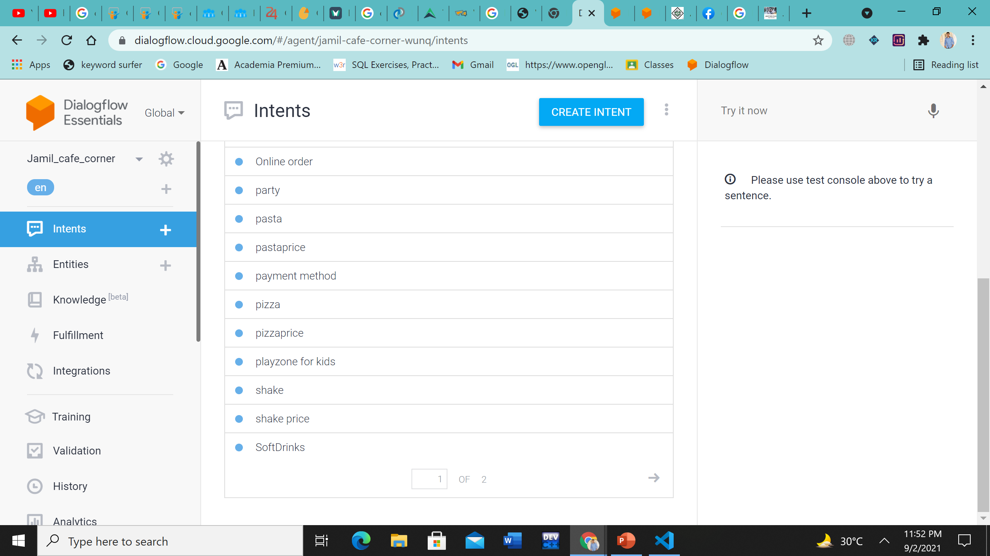
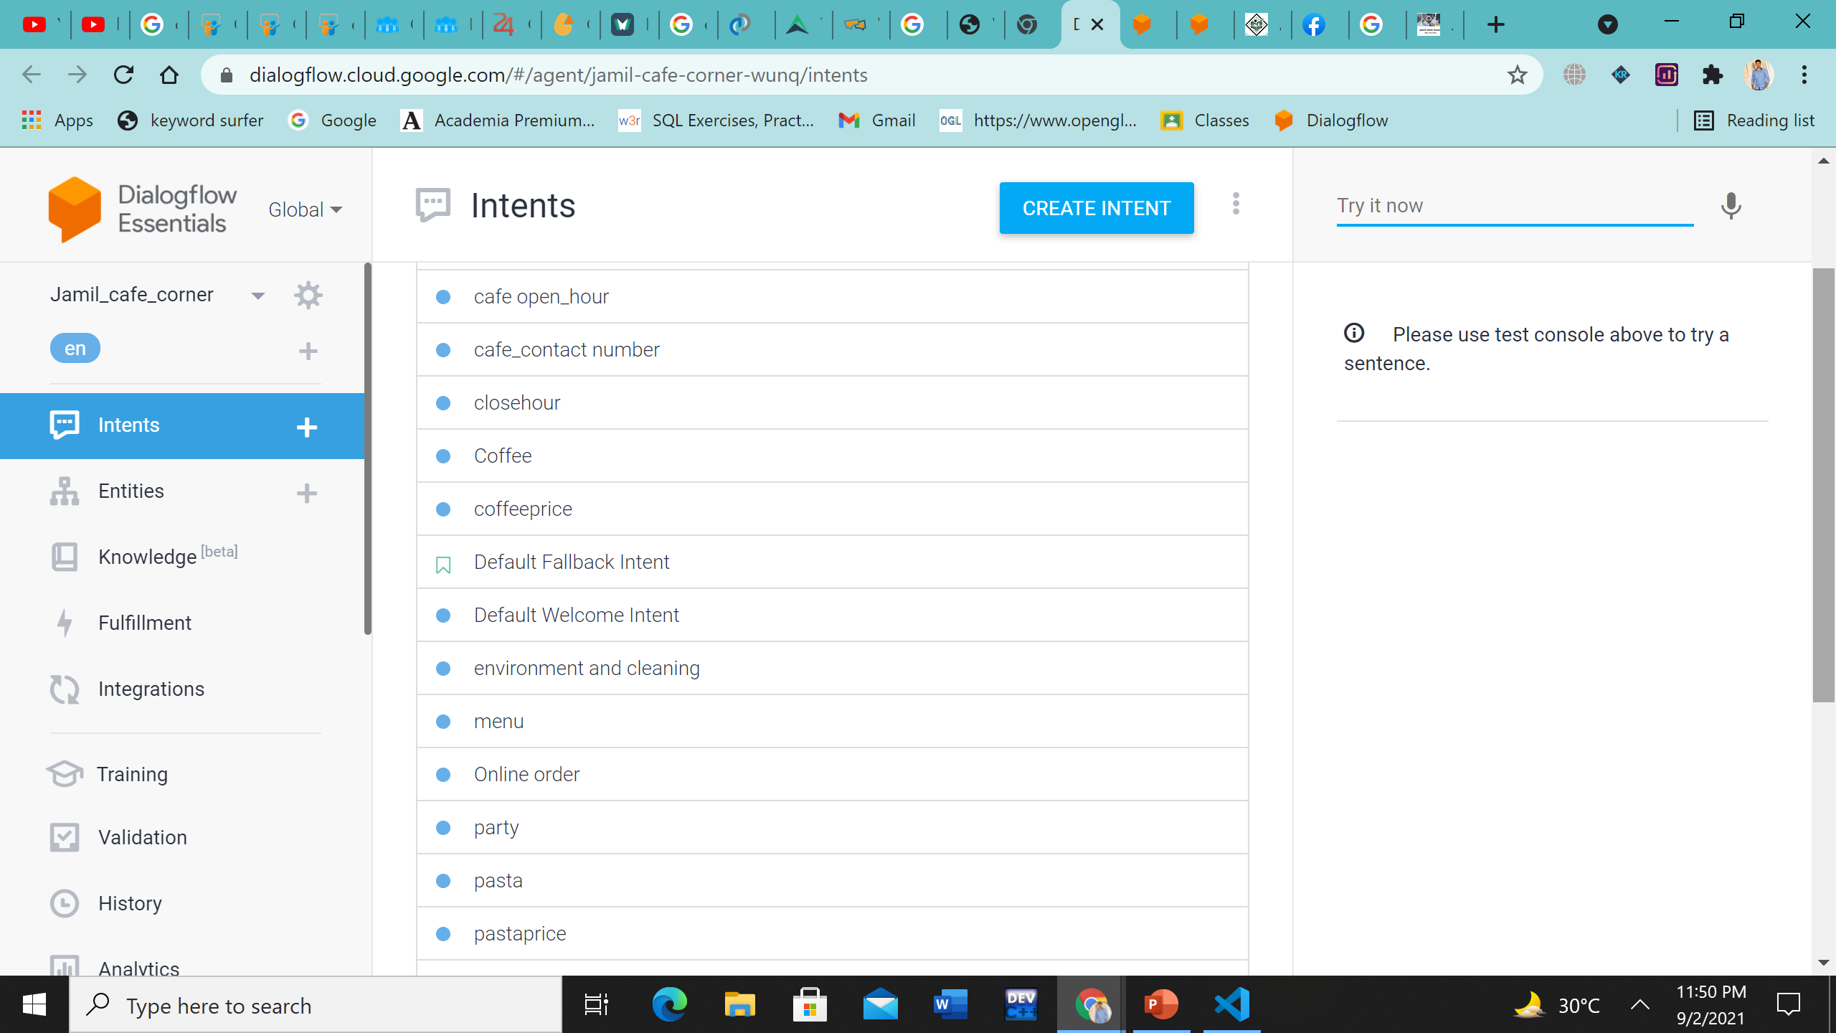

INTENT

Slide 8
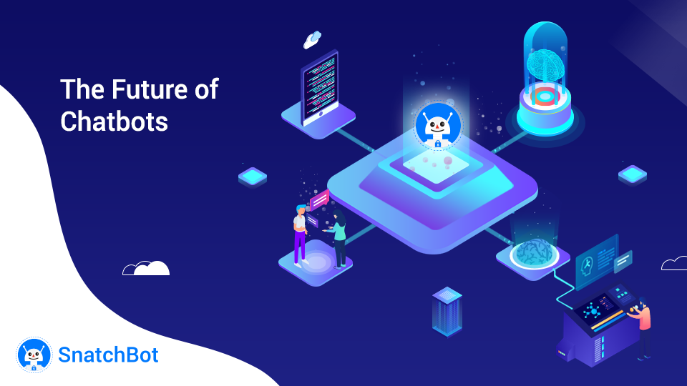
INTEGRATION
WEB DEMO INTEGRATION
WEBSITE INTEGRATION

Slide 9
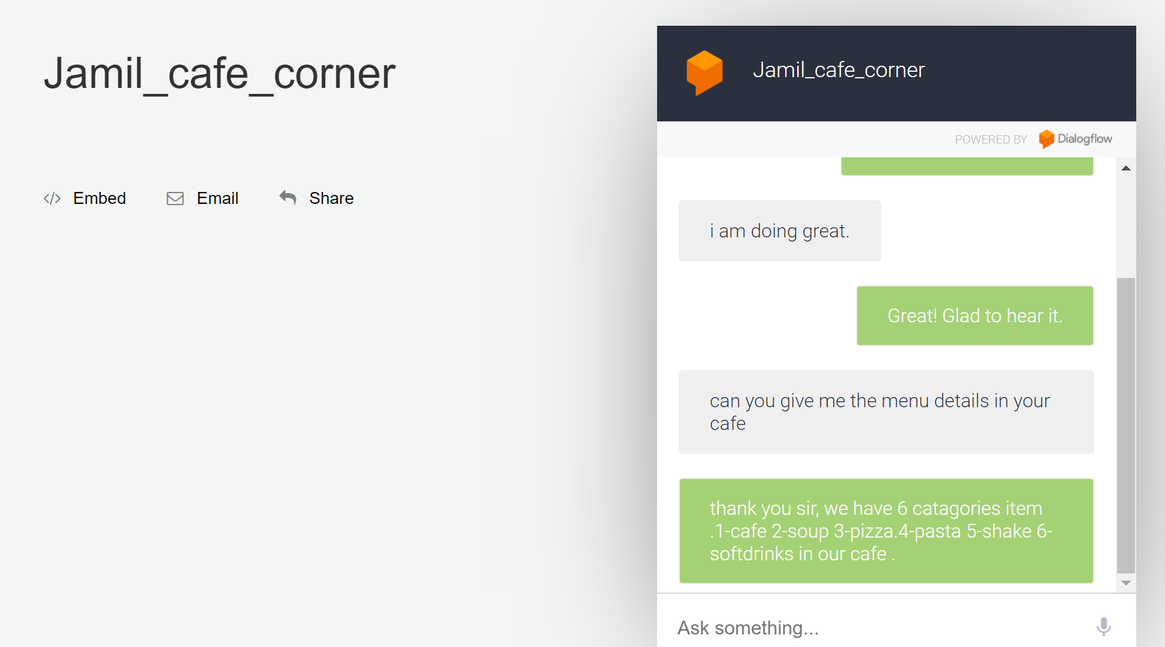
WEB DEMO INTEGRATION

Slide 10
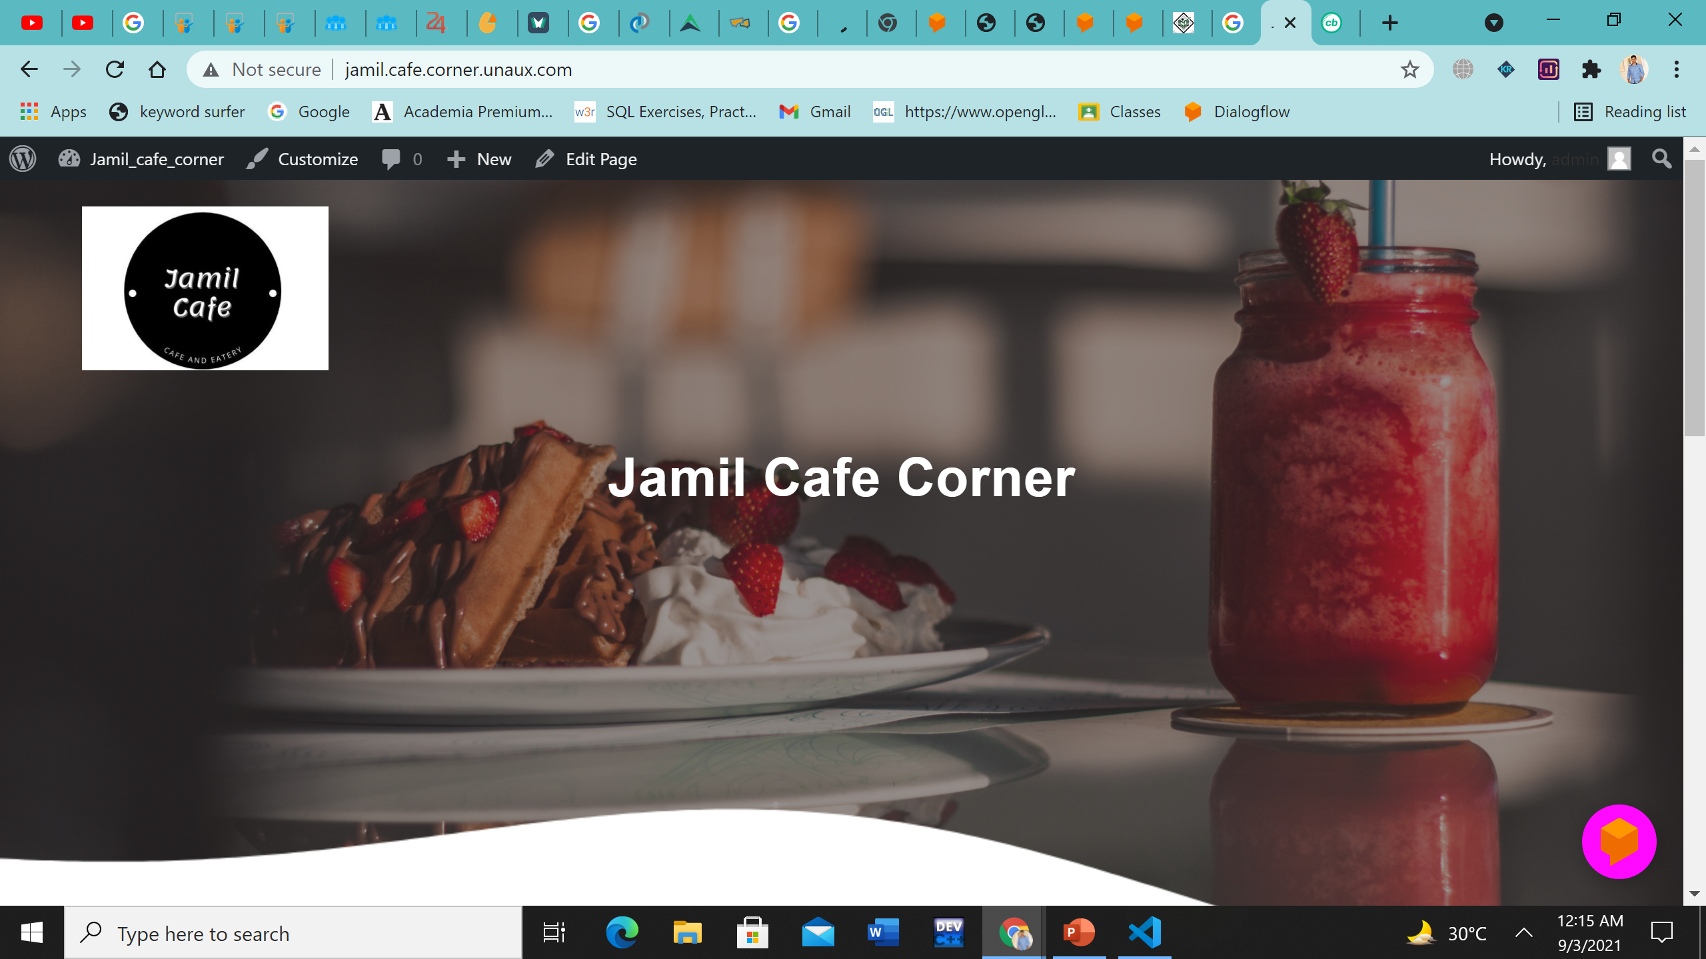
WEB SITE INTEGRATION

Slide 11
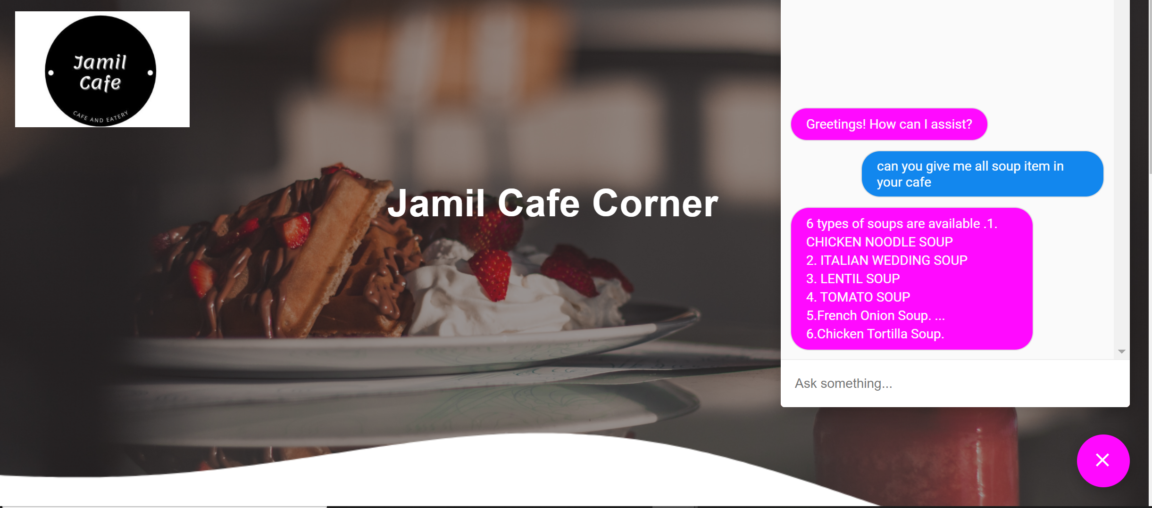
WEB SITE INTEGRATION

Slide 12
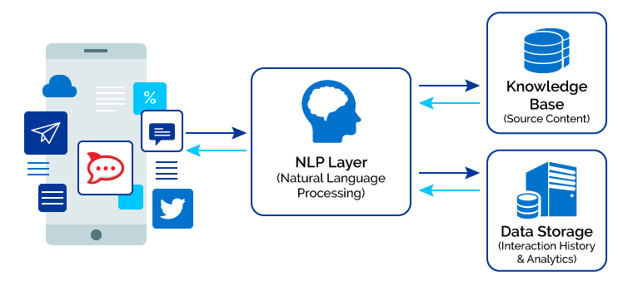
Chatbot technology – How do they work?
“Chatbots work by analyzing and identifying the intent of the user’s request to extract relevant entities, which is the most important task of a chatbot. Once the analysis is done appropriate response is delivered to the user. ”

Slide 13
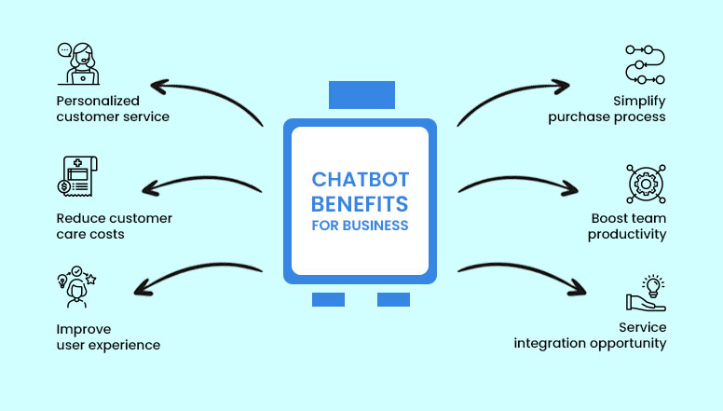
Chatbots important for business

Slide 14
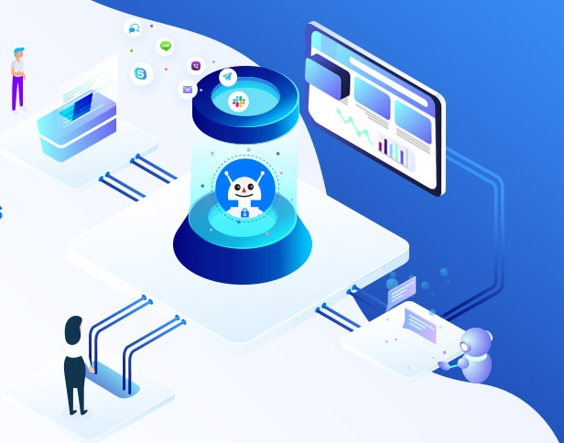
COMMON USECASE OF CHATBOT
✔️QUICK ISSUE RESOLUTIOIN TO SIMPLER QUERIES
✔️ BOOKING AND MAKING RESERVATIONS
✔️ BUYING PRODUCTS
✔️ SPEAKING TO AGENT WITHOUT BEING ON PHONE CALLS
✔️ACCESS IMPORTANT FORMS LIKE CREDIT CARD
✔️AUTHORIZATION
✔️OPENING AND CLOSING DETAILS
✔️PROVIDE FEEDBACK

Slide 15
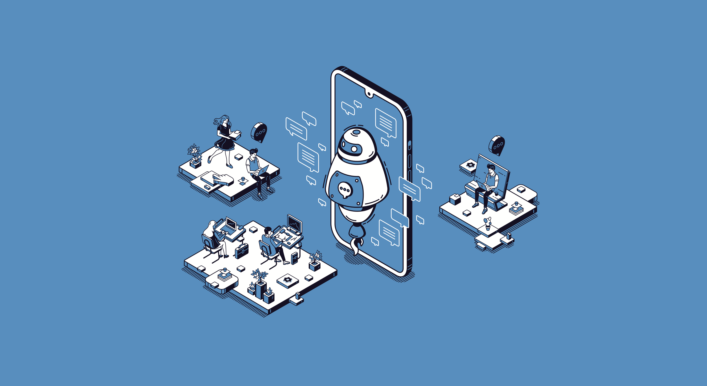
Why our business need a chatbot?
Our customer service agents are often too busy and overwhelmed.
want to provide continuous support
want a better User Experience
looking to generate more leads
Building an App is not affordable

Slide 16
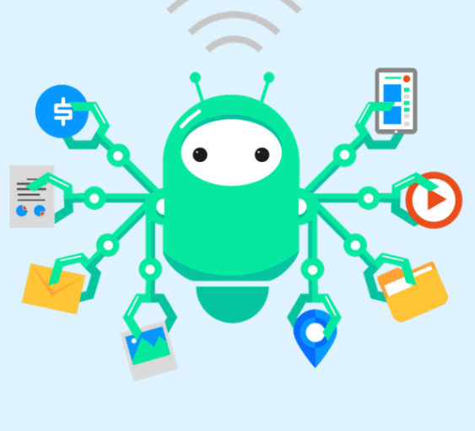
ADVANTAGE OF CHATBOT
✔️ Earn bigger profit
✔️ Engage more interactions
✔️ Grow user base
✔️ No time bounded
✔️ 24 hours service
✔️ It can reach more at once
✔️ Instant messaging
✔️ Immediate Response

Slide 17
DISADVANTAGE OF CHATBOT
✔️ Need to monitor the behaviour.Dont lose the user we have
✔️ Need to check if the messages are ethical
✔️ Bad Review
✔️ Attract Spammers
✔️ Sometimes Target The Wrong Audience

Slide 18
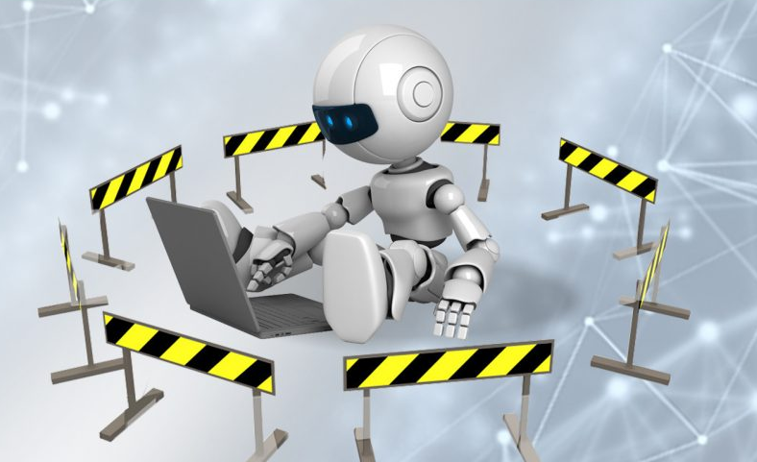
limitations of our chatbots
✔️ chatbot security risk
✔️ Limited integration platforms
✔️ Limited number of users
✔️ Limitations in chat automation
✔️ No automatic follow up with leads
✔️ No Facebook Ads integration
✔️ No push-notifications
✔️ limited lead routing

Slide 19
Future work of our Chatbot
✔️More Impact in our businesses
✔️ Integrate with more different platform
✔️ Stronger Privacy should be maintained
✔️ Bot responsed should be more realistic and faster
✔️ Developed the payment system

Slide 20


